Slide 1
Micromouse in Webots
COMP 513 – Autonomous agents
Manos stefanakis

Slide 2

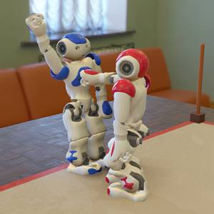
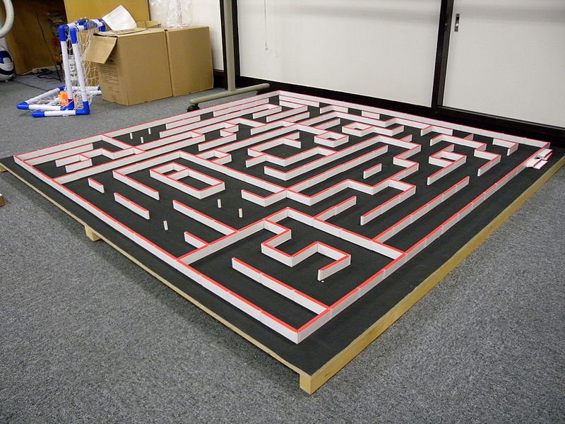
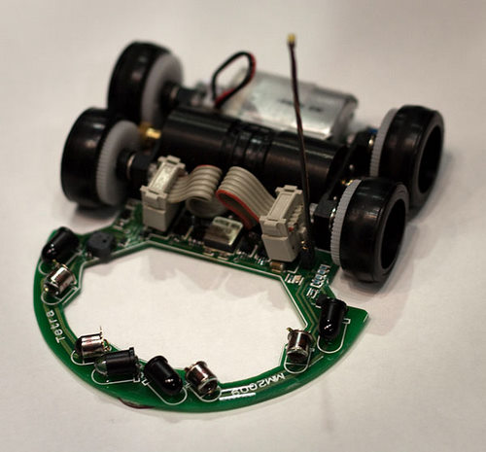
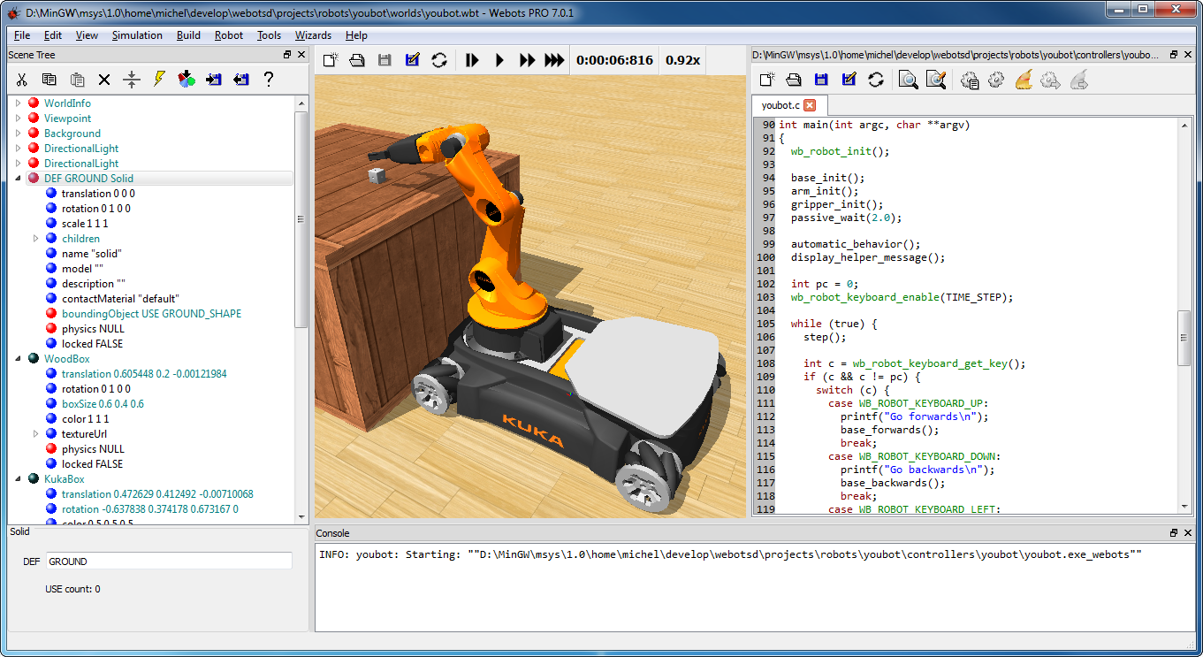
Micromouse
Webots
A competition where a small mouse robot solves a 16x16 block maze
Maze Solving: Moving/searching around for the best path to reach the center. Use of searching algorithms to compute shortest path.
Performance: The shortest path is not always the fastest. Straight lines enable the mouse to accelerate.
Robot Simulation Software
Visual 3D environment = World
Robot Programming = Controller

Slide 3
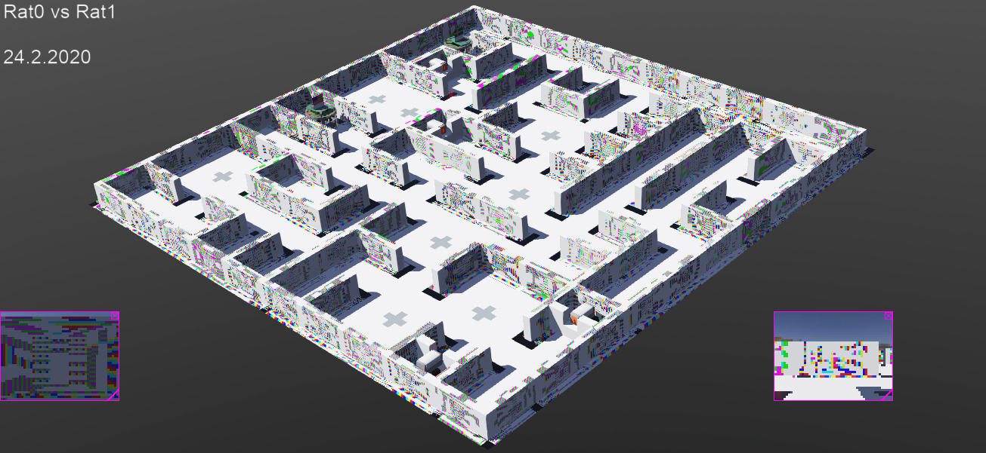
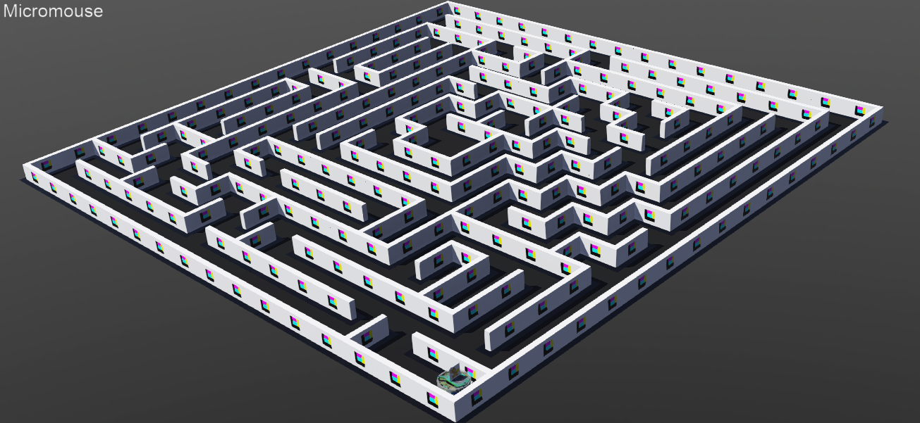
How was it built?
Using a Demo from Webots projects called Rats Life
Fundamental elements, like the robot, the walls and their handling code, were kept and programmed to serve the Micromouse project
A lot faster than building everything from scratch… as I found out...
FROM
TO

Slide 4
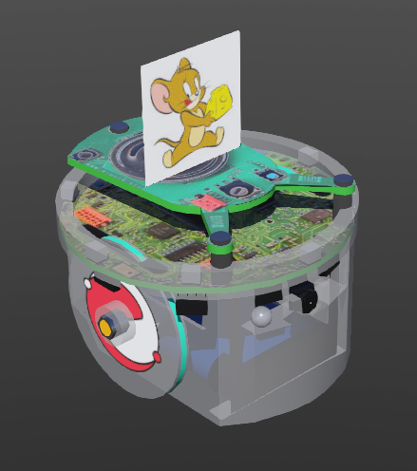
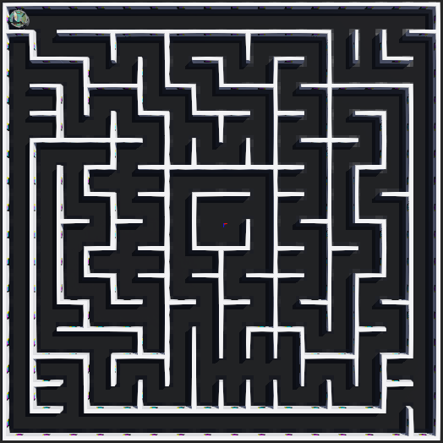
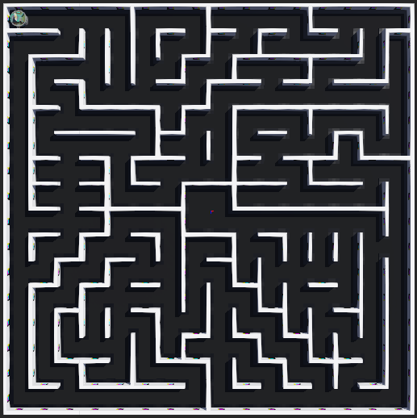
The Micromouse World
The Robot (E-puck):
Already modelled in Webots. Offered 8 IR sensors for distance estimation and the rotary encoders from its stepper motors helped calculate the traveling distance and rotation.
Maze generation:
Created a function to enable us reading over 400 mazes from old competitions for testing our Algorithm against well thought maze designs

Slide 5
The Controllers
One for the environment and one for the robot:
The environment
Half is created using the Webots World Editor UI (adding walls, wall joints, etc.) and half by programming the controller (in C) in a number of functions of witch the most altered is maze_generation.c file containing the function for importing mazes from the maze archive.
The Robot
The controller (in Java) is the “brains” of the Autonomous Agent and is responsible to guide the robot to the centre of the maze
Odometry → Localization & Mapping → Searching Algorithm

Slide 6
Odometry
The use of data from motion sensors to estimate change in position over time.
Use of the rotary encoders of the stepper motors to detect if the robot has reached the centre of the next cell
Errors are corrected using the IR distance sensors’ input by quantising the robot’s steps

Slide 7
Localization & Mapping
Since the robot now can detect if it has travelled to the next cell:
It can calculate the relative orientation by monitoring its rotation from the input of the rotary encoders given its known direction at the starting cell.
Finally, we can now estimate the location of the robot in the maze since we know how many step it has travelled and the direction at each step.

Slide 8
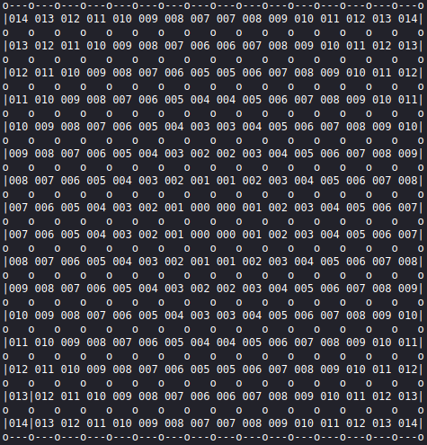
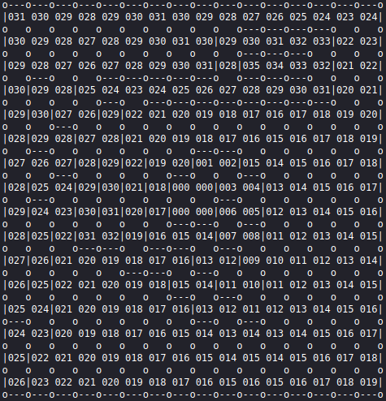
Flood Fill Algorithm
A variation of the Bellman-Ford Algorithm:
Our goal, the centre of the maze has a weight of zero and the distance between two cells equals one (no diagonals):
Walls block the path, so:

Slide 9
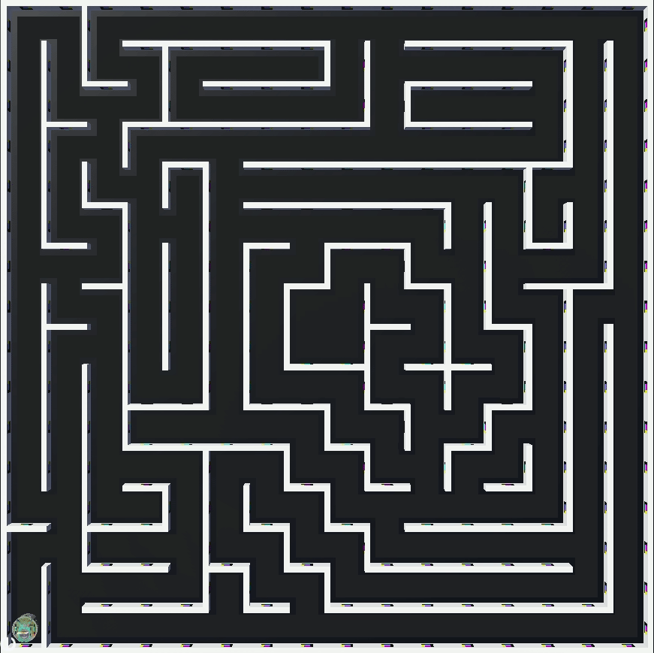
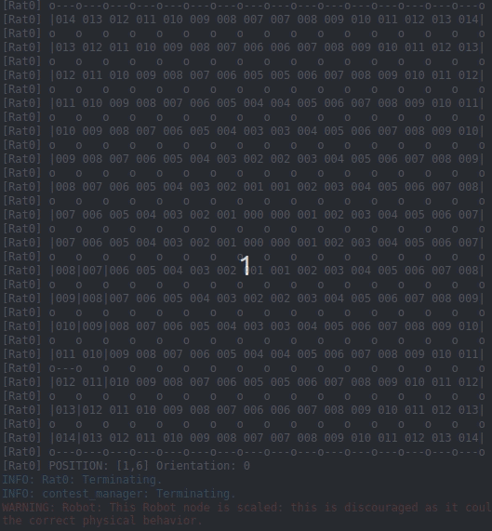
Results
Combining our efforts, we can use the robots position and the weights of the path to stir the robot towards the centre of the maze.

